Slide 1
Stock Trading AI Analyst
Michael Ludwikowski
B.S. Computer Science
Dr. Hayes
April 2026

Slide 2
The Problem
New traders enter the market without practical experience
Most lose money due to poor risk understanding
Existing tools are too advanced or too simplified
No safe environment to learn before risking real money

Slide 3
Project Goals
Simulate real trading with fake money
Provide AI-generated buy, sell, or hold recommendations
Display charts, portfolio data, and gain/loss feedback
Offer practice and simulation modes for guided learning
Store all user activity persistently

Slide 4
System Architecture
Flask web app - routes, sessions, multi-page UI
SQLite database - users, accounts, holdings, transactions
Bokeh - interactive stock charts
Ollama - LLM based predictions + fallback

Slide 5
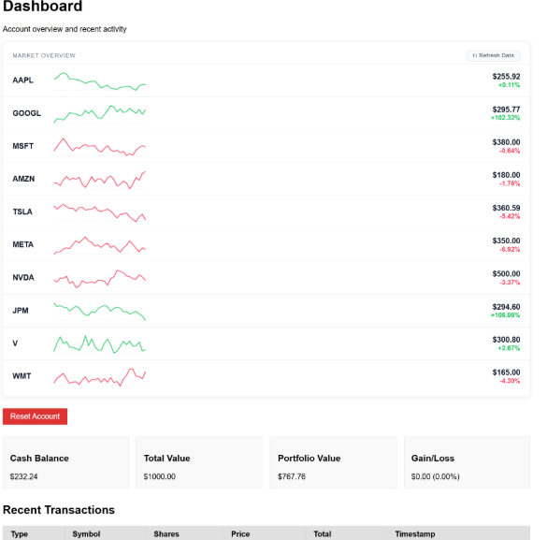
Core Feature: Trading
Register and log in with a personal account
Start with $1,000 in simulated funds
Search stocks by symbol
Buy and sell shares through the web interface
Portfolio and balance update immediately after each trade

Slide 6
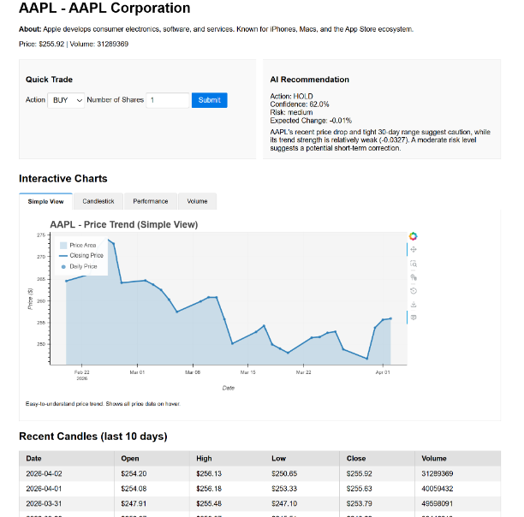

Core Feature: AI Recommendations
Powered by Llama model 3.2 running locally
Returns BUY / SELL / HOLD with confidence and risk level
Includes a short rationale for the recommendation
Available on every stock detail page

Slide 7
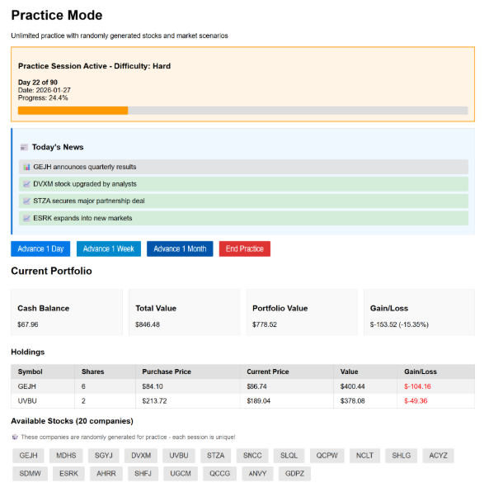
Practice and Simulation Modes
Practice Mode - synthetic companies, news events, difficulty levels
Simulation Mode - replay real historical market data over time
Both modes are isolated from the main trading account
Designed for learning without affecting real portfolio state

Slide 8
Challenges Overcome
API rate limits - caching and fallback behavior added
AI availability - rule-based fallback keeps app running
Full-stack integration - connected data, AI, trading, and UI into one system
Scope management - prioritized core flows over unfinished features

Slide 9
Future Enhancements
Complete multi-account workflow for the main UI
Improve AI performance tracking and reporting
Add expanded educational tools (alerts, quizzes, learning modules)
Stronger account security and portfolio analytics
Load times for pages / preloading pages & AI recommendations.

Slide 10
Summary
Functional educational trading platform in Python + Flask
Integrated real market data, AI analysis, and persistent storage
Covered practice and simulation modes for beginner learning

Slide 11
Questions?
MRLudwikowski@student.csuniv.edu
Source: github.com/MichaelLudwikowski/MLud-CSU-Senior-Project

